Slide 1


T1
T1
T2
T4
T1
T1
T9
T9
T6
T6
T 6
T1
T6
T6
T1
T1
Swinger
Swinger
DT
Swinger
T1
P1
P2
P3
P4
The Car
TABLE
CHAIR
x1
Toilet
x2
Bush
Barricade
Plate Rack
PROPS

Slide 2



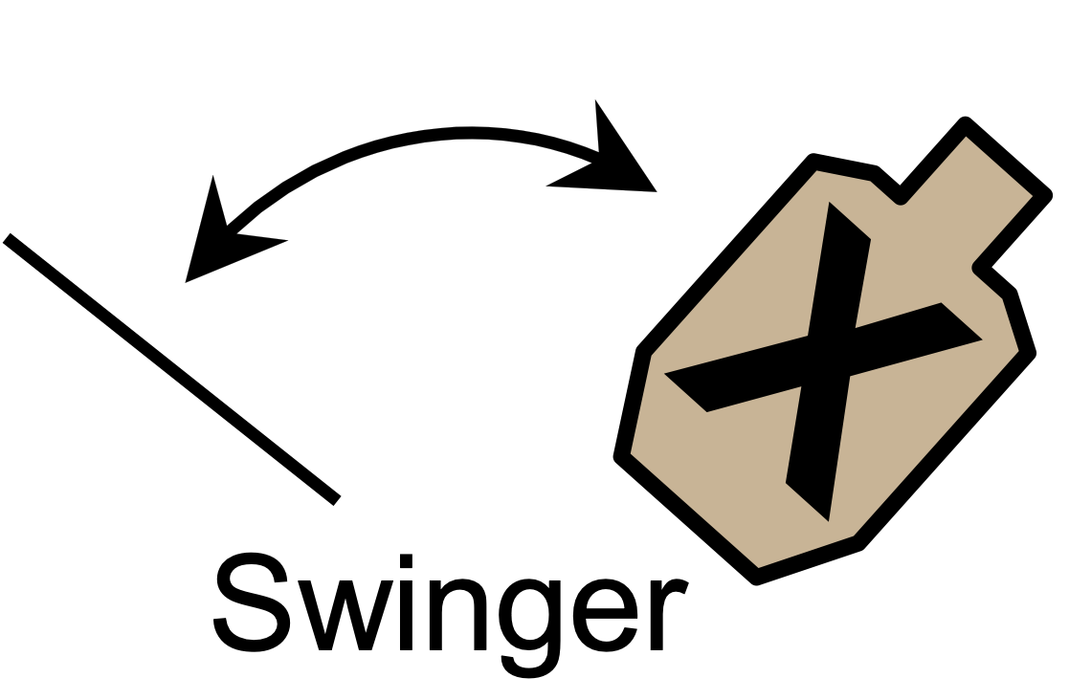
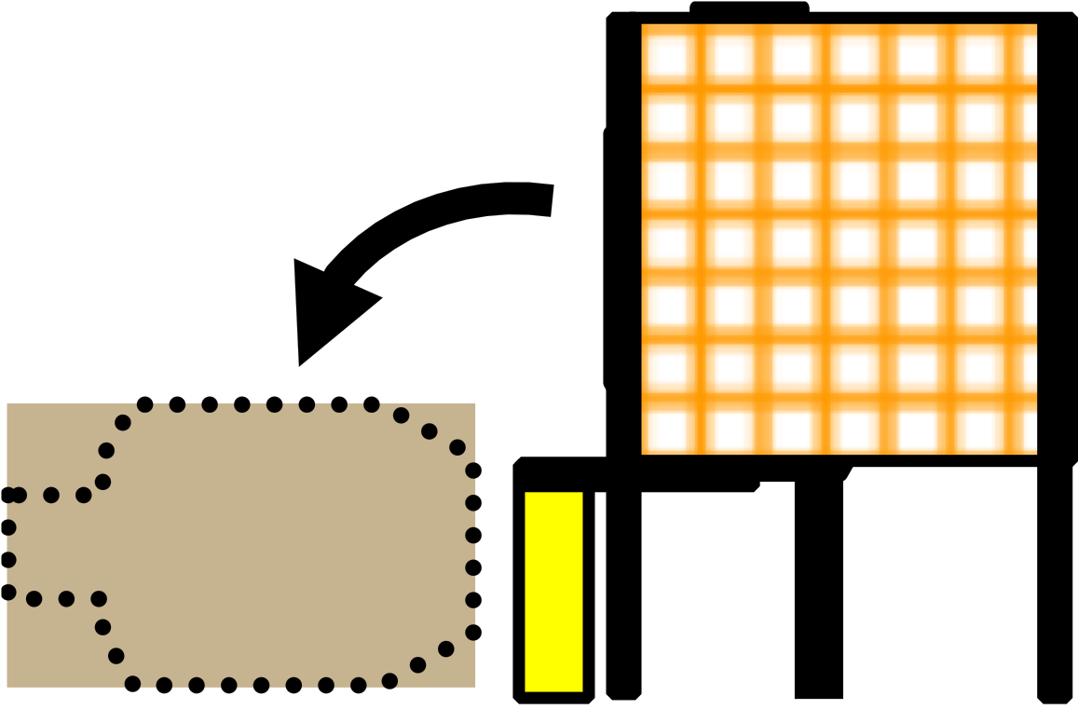
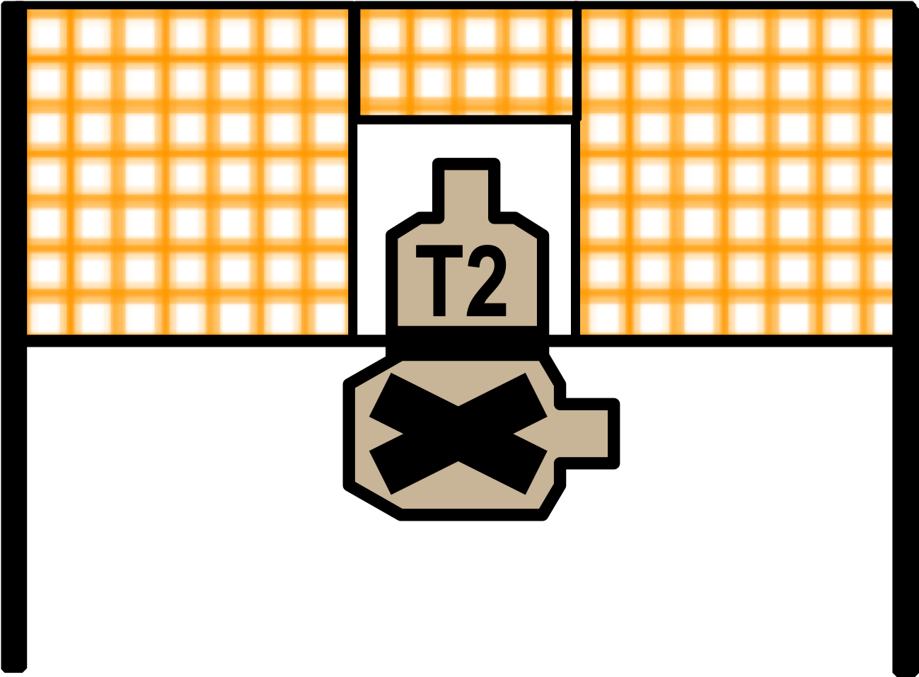
Wall Wall Wall Wall Wall
x1
x2
x1
x2
8
8
8
8
8
8
3
3
3
CHAIR
T7
DDT
T1
T2
T3
T9
T1
T1
DT
6
6
6
6
T5
T3
T4
4
4
4
T4
T6
T6
T4
Out & Back
Out & Back
P1
P2
P3
P4
T7
T8
T9
T1
T1
SP
TABLE
Overhead Structure
PCC
Rack
Stage 1 – Pin Bay
Pin Bay 30’ = 4.11” 1’ = 0.137”
Notes:
Reduced distance to T9, must be 20 yards max.

Slide 3
Overhead Structure
Stage 2
30’ = 3.76” 1’ – 0.125”
T7
DDT
PCC
Rack
T1
T2
T3
T9
T1
T1
DT
T4
T5
T6
T3
T4
CHAIR
T6
T4
Out & Back
Out & Back
P1
P2
T7
T8
T9
T1
T1
SP
P3
P4
TABLE
8
8
8
8
8
3
3
3
6
6
6
6
x1
x2
4
4
4
x1
x2

Slide 4
6
6
6
3
3
3
6
6
6
6
8
8
8
8
8
Overhead Structure
Stage 3
30’ = 4.25” 1’ = 0.142”
x1
x2
x1
x2
T7
DDT
PCC
Rack
T1
T2
T3
T9
T1
T1
DT
T4
T5
T6
T3
T4
CHAIR
T6
T4
Out & Back
Out & Back
P1
P2
T7
T8
T9
T1
T1
SP
P3
P4
TABLE

Slide 5
x1
x2
x1
x2
4
4
4
3
3
3
6
6
6
6
8
8
8
8
8
Overhead Structure
Stage 4
30’ = 4.25” 1’ = 0.142”
T7
DDT
PCC
Rack
T1
T2
T3
T9
T1
T1
DT
T4
T5
T6
T3
T4
CHAIR
T6
T4
Out & Back
Out & Back
P1
P2
T7
T8
T9
T1
T1
SP
P3
P4
TABLE

Slide 6
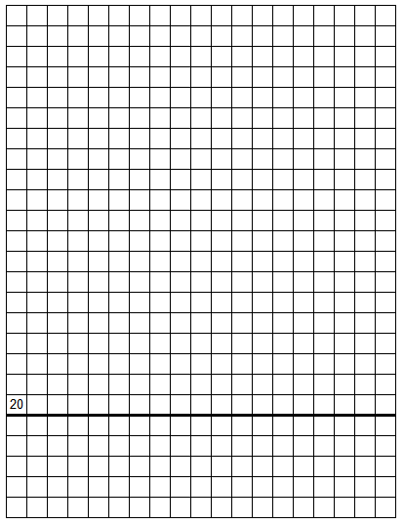
Stage 5
PISTOL HOUSE
30’ = 3.84” 1’ = 0.128”
PCC
Rack
CHAIR
P1
P2
TABLE
P3
P4
SP
T7
DDT
8
8
8
8
3
3
3
x1
x2
T1
T2
T3
T9
T1
T1
DT
8
x1
x2
T4
6
6
6
6
T4
T5
T6
T3
4
4
4
4
T6
T4
Out & Back
Out & Back
T7
T8
T9
T1
T1

Slide 7
Challenge Stage 6
100 Yard Rifle Range
30’ = 4.30” 1’ = 0.143”
T7
DDT
PCC
Rack
T1
T2
T3
T9
T1
T1
DT
T4
T5
T6
T3
T4
CHAIR
T6
T4
Out & Back
Out & Back
P1
P2
T7
T8
T9
T1
T1
SP
P3
P4
TABLE
8
8
8
8
8
3
3
3
6
6
6
6
4
4
4
4
x1
x2
x1
x2

Slide 8
Non-Shaded area (15’)
is relatively flat. Should
be ok for walls.
Area shaded YELLOW
Is a bit of an incline to
the sides. Not good for walls. Can be used for target placement.
Stage 7
185-yard rifle range
15 feet = 2.03 inches
1 foot = 0.135 inches
T7
PCC
Rack
T1
T2
T3
T9
T1
T4
T5
T6
T3
T4
CHAIR
T7
T8
T9
T6
T4
T1
TABLE
DT
DDT
Out & Back
Out & Back
P1
P2
T1
T1
SP
P3
P4
8
8
8
8
8
3
3
3
6
6
6
6
4
4
4
4
x1
x2
x1
x2

Slide 9
8
8
8
8
8
Stage 8
North Turkey Bay
30 feet = 3.51 inches
1 foot = 0.117 inches
6
6
6
6
x1
x2
4
4
4
4
3
3
3
x1
x2
T7
DDT
PCC
Rack
T1
T2
T3
T9
T1
T1
DT
T4
T5
T6
T3
T4
CHAIR
T6
T4
Out & Back
Out & Back
P1
P2
T7
T8
T9
T1
T1
SP
P3
P4
TABLE

Slide 10
Stage 9
South Turkey Bay
30 feet = 3.85 inches
1 foot = 0.128 inches
8
8
8
8
8
x1
x2
6
6
6
6
x1
x2
3
3
3
4
4
4
4
T7
DDT
PCC
Rack
T1
T2
T3
T9
T1
T1
DT
T4
T5
T6
T3
T4
Out & Back
Out & Back
P1
P2
CHAIR
T7
T8
T9
T6
T4
T1
T1
SP
P3
P4
TABLE

Slide 11
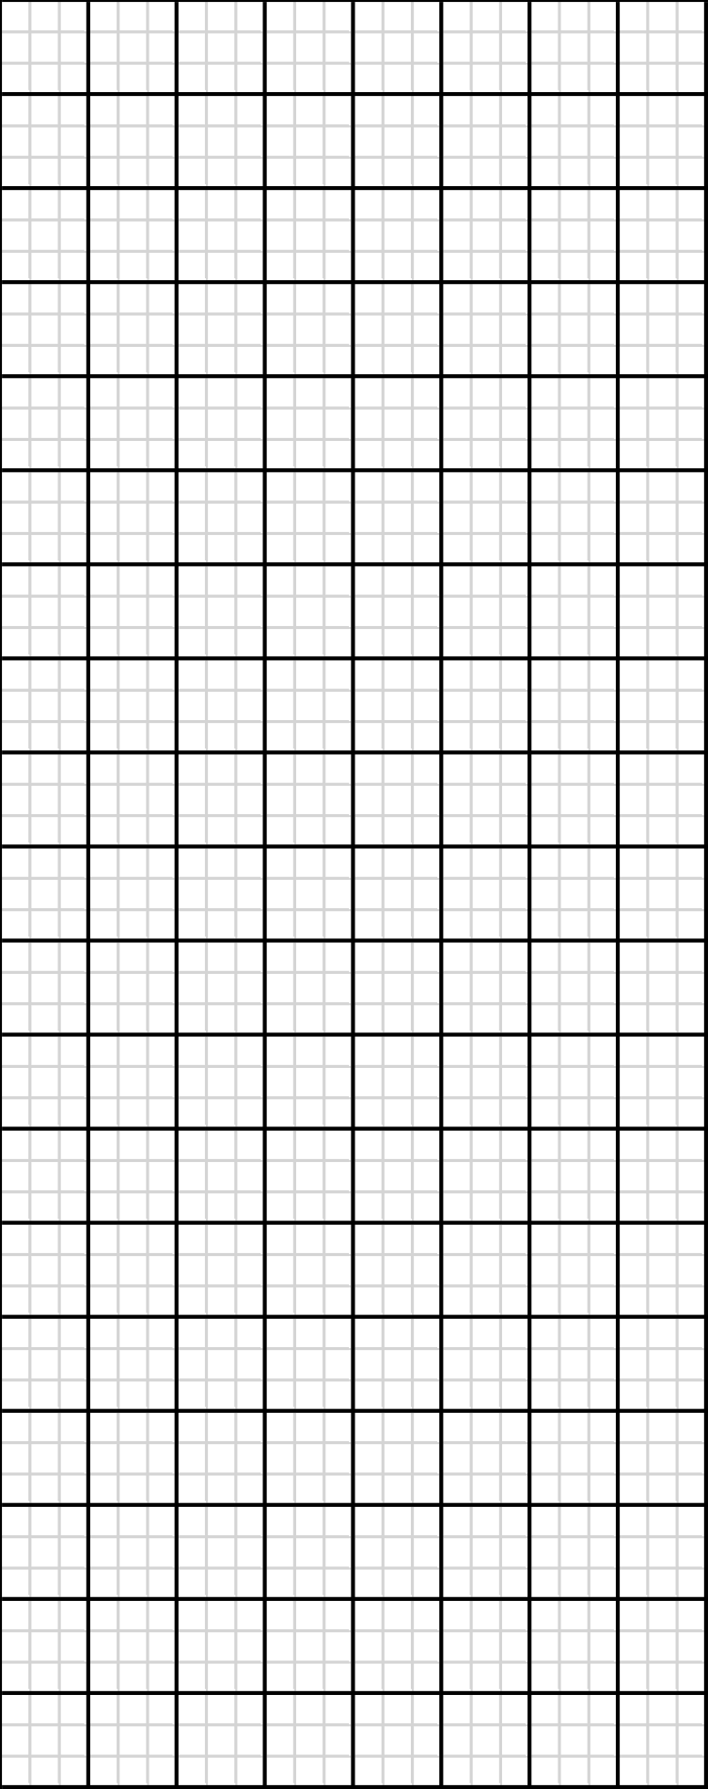
Warm-Up Stage
All Bays
8
8
6
6
4
4
3
3
T1
T2
T3
T4
T5
T6
T7
T8
P1
P2
x2
P3
P4
T9
T6
T7
T4
T9
T9
x1
x2
x1
T1
T1

