Slide 1


T1
T1
T2
T4
T1
T1
T9
T9
T6
T6
T 6
T1
T6
T6
T1
T1
Swinger
Swinger
DT
Swinger
T1
P1
P2
P3
P4
The Car
TABLE
CHAIR
x1
Toilet
x2
Bush
Barricade
Plate Rack
PROPS

Slide 2

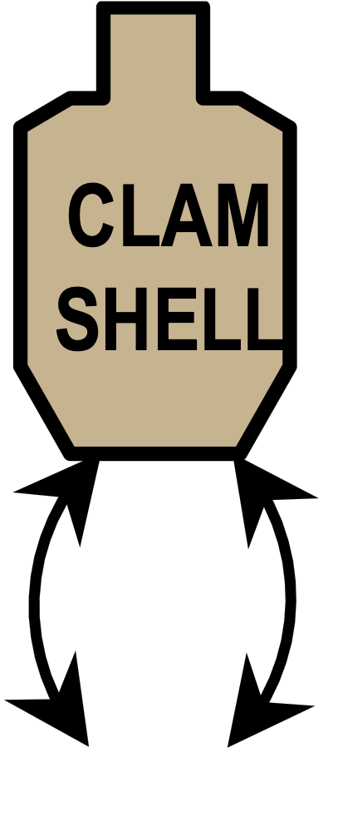

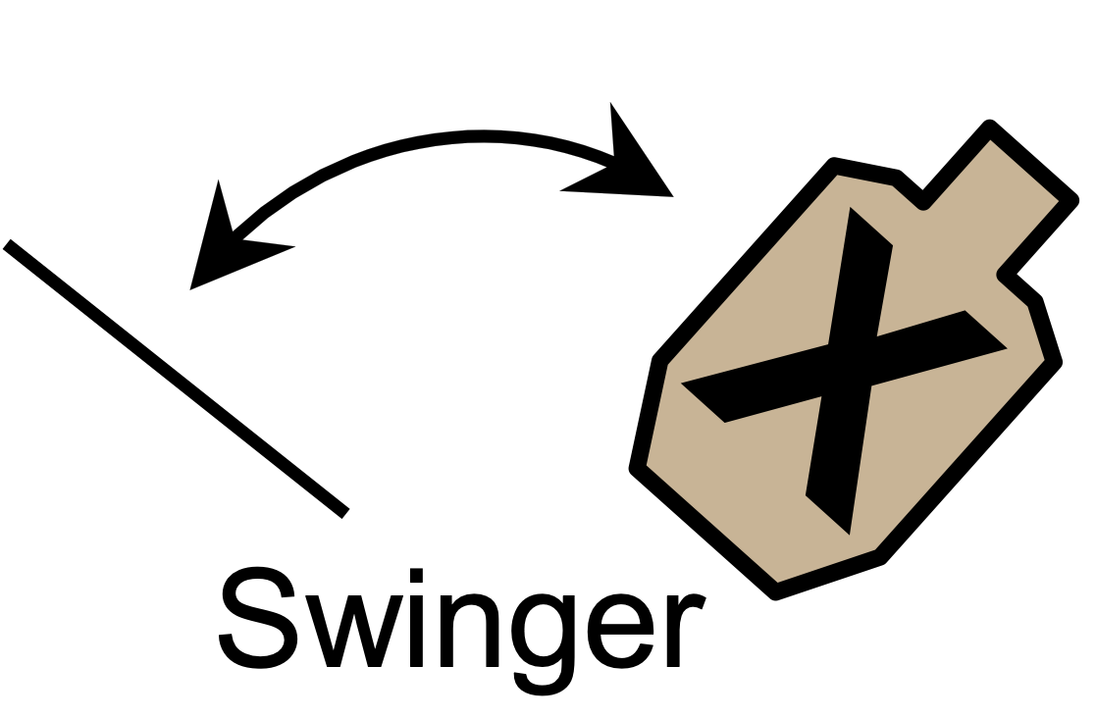
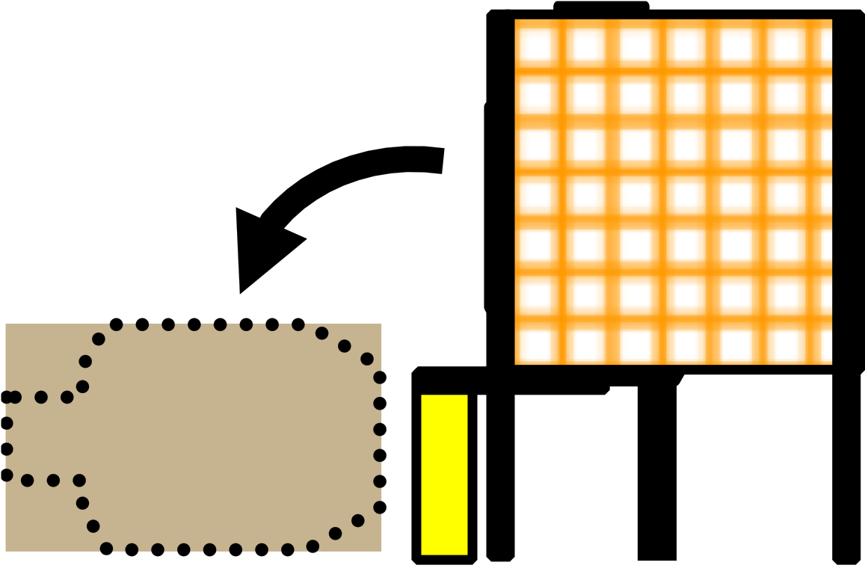
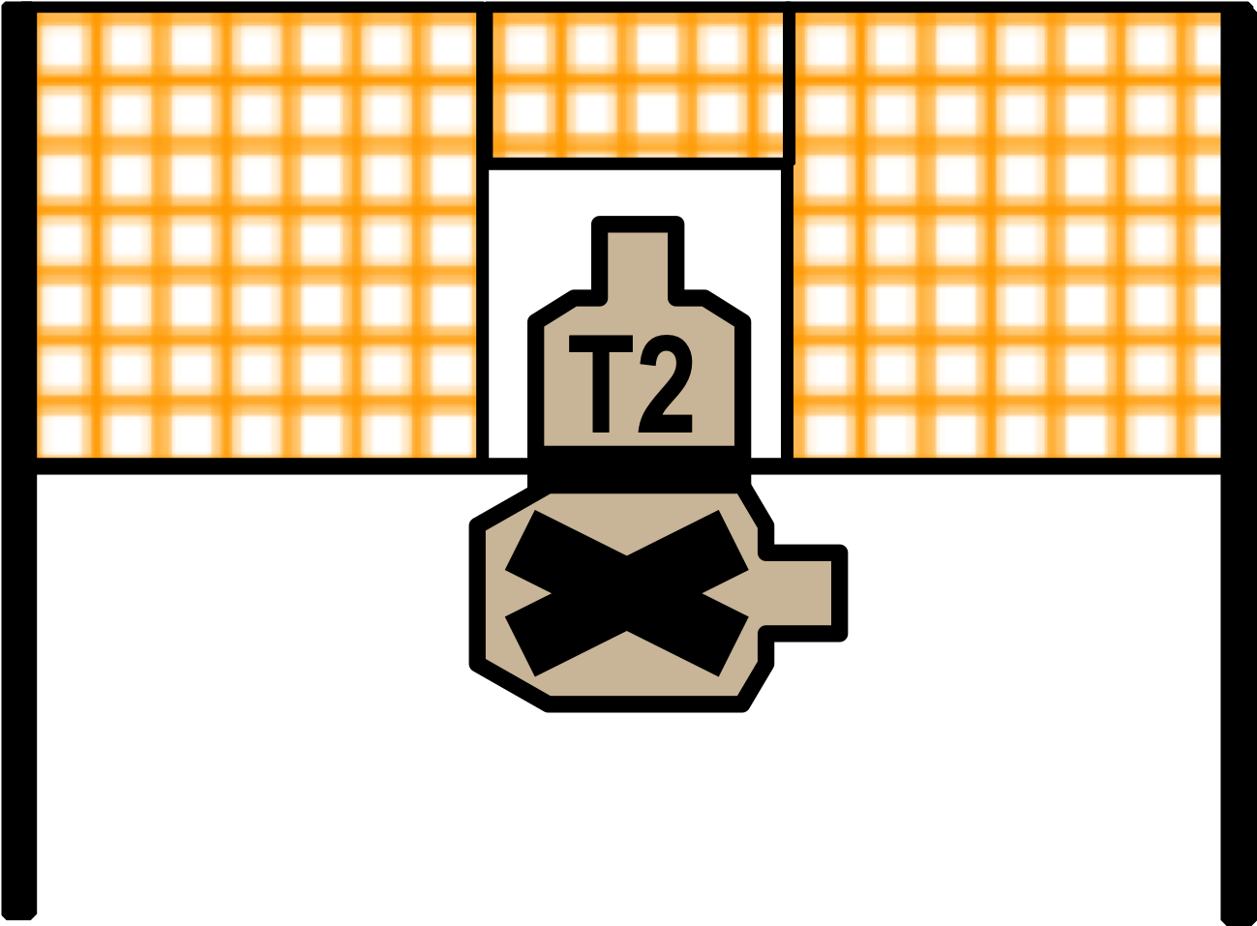
Wall Wall Wall Wall Wall
x1
x2
x1
x2
8
8
8
8
8
8
3
3
3
CHAIR
T7
DDT
T1
T2
T3
T9
T1
T1
DT
6
6
6
6
T5
T3
T4
4
4
4
T4
T6
T6
T4
Out & Back
Out & Back
P1
P2
P3
P4
T7
T8
T9
T1
T1
SP
TABLE
Overhead Structure
PCC
Rack
Challenge Stage 1 - Regular Stage 5
Pin Bay 30’ = 4.11” 1’ = 0.137”
Notes:
Reduced distance to T9, must be 20 yards max.

Slide 3

Tri-County Sportsmen’s League – IDPA
TERORISTS INVADE A MOVIE THEATER.
Stage #1
2024 Challenge
Challenge Stage 1
Regular Stage 5
Pin Bay
Concealment: | Yes | Pistol & PCC: | Pistol & PCC: Loaded to division capacity, lying flat on top of low cover table, trigger guard over X, muzzle pointed down range. Additional loading devices on person. | Scoring: Start / Stop | Unlimited Audible / Last Shot
Style: | Freestyle | Reload: | IDPA Approved | Min. Rounds: | 18
Start: | Starting from low cover (at least one knee on ground) hands on table without touching the firearm.
Procedure: | Retrieve firearm and engage all targets with 2 rounds each from low cover (at least one knee on ground). Engage all targets in tactical priority. All threats must be engaged from within the fault lines, behind the table and between the barrels at P1.
**Notes: | 180-degree muzzle rule in effect. Each row designates a level of priority.
See you Next Year at the 2025 Tri-County Sportsmen Challenge
CoF designed by: Steve Nesmith
Notes:
Changed Pistol & PCC text
Change Start text

Slide 4
Overhead Structure
Challenge Stage 2
Regular Stage 4
30’ = 3.76” 1’ – 0.125”
T7
DDT
PCC
Rack
T1
T2
T3
T9
T1
T1
DT
T4
T5
T6
T3
T4
CHAIR
T6
T4
Out & Back
Out & Back
P1
P2
T7
T8
T9
T1
T1
SP
P3
P4
TABLE
8
8
8
8
8
3
3
3
6
6
6
6
x1
x2
4
4
4
x1
x2

Slide 5

Tri-County Sportsmen's League IDPA
CROSS ROADS
You’re cutting through a bad part of town. Keep your head on swivel.
Threats are coming at you from every angle.
Stage #2
Challenge 2024
Challenge Stage 2
Regular Stage 4
Concealment: | Yes | Pistol: PCC: | Pistol loaded to division capacity and holstered. PCC loaded to division capacity, low ready. | Scoring: Start / Stop | Unlimited Audible / Last Shot
Style: | Freestyle | Reload: | IDPA Approved | Min. Rounds: | 18
Start: | At P1 (X), one foot touching orange strip.
Procedure: | Engage targets with 2 rounds each in tactical priority using available cover and in the open. T4 and T5 are surprise targets engaged in the open.
**Notes: | 180-degree muzzle rule in effect. Start position from either side. Shooter's preference.
Don’t forget to sign up for the TCSL October IDPA match!
CoF designed by: ERA3
Notes:
Adjusted Pistol/PCC text
Removed redundant text from Start and At Signal.

Slide 6
6
6
6
3
3
3
6
6
6
6
8
8
8
8
8
x1
x2
Overhead Structure
Challenge Stage 3
Regular Stage 3
30’ = 4.25” 1’ = 0.142”
x1
x2
T7
DDT
PCC
Rack
T1
T2
T3
T9
T1
T1
DT
T4
T5
T6
T3
T4
CHAIR
T6
T4
Out & Back
Out & Back
P1
P2
T7
T8
T9
T1
T1
SP
P3
P4
TABLE

Slide 7
Tri-County Sportsmen's League IDPA
Standing in your living room you see a
gang of armed thugs entering your house.
Stage #3
Challenge2024
Challenge Stage 3
Regular Stage 3
Concealment: | Yes | Pistol: PCC: | Pistol loaded to division capacity and holstered. PCC loaded to division capacity and placed on/in rack. | Scoring: Start / Stop | Unlimited Audible / Last Shot
Style: | Freestyle | Reload: | IDPA Approved | Min. Rounds: | 18
Start: | Centered on wall (X), Both palms flat on mark on wall.
Procedure: | Draw / Retrieve firearm and engage all threats with 2 rounds each as they become visible from cover and in the open.T7 thru T9 are in the open.
**Notes: | T7 is a single turning drop turner, activated by a stomp box. 180-degree muzzle rule in effect.
Don’t forget to sign up for the October TCSL monthly match!
CoF designed by: Pam Hasselbach
Notes:
Adjusted:
Pistol/PCC
Start
At Signal

Slide 8
x1
x2
x1
x2
4
4
4
3
3
3
6
6
6
6
8
8
8
8
8
Overhead Structure
Challenge Stage 4
Regular Stage 2
30’ = 4.25” 1’ = 0.142”
T7
DDT
PCC
Rack
T1
T2
T3
T9
T1
T1
DT
T4
T5
T6
T3
T4
CHAIR
T6
T4
Out & Back
Out & Back
P1
P2
T7
T8
T9
T1
T1
SP
P3
P4
TABLE

Slide 9
Tri-County Sportsmen’s League – IDPA
HOLE IN THE WALL
You’re clearing a house. Keep your guard up and
don’t overlook the HOLE IN THE WALLs.
Stage #4
Challenge 2024
Challenge Stage 4
Regular Stage 2
Concealment: | Yes | Pistol: PCC: | Pistol loaded to division capacity and holstered. PCC loaded to division capacity and held at low ready. | Scoring: Start / Stop | Unlimited Audible / Last Shot
Style: | Freestyle | Reload: | IDPA Approved | Min. Rounds: | 18
Start: | Centered on wall (X).
Procedure: | Engage threats with 2 rounds each in tactical priority as they become visible from cover and in the open. Targets 2, 3 and 6 are in the open.
**Notes: | 180-degree muzzle rule in effect.
See you Next Year at the 2025 Tri-County Sportsmen Challenge
CoF designed by: ERA3
Notes:
Adjusted:
Pistol/PCC
Start
At Signal

Slide 10
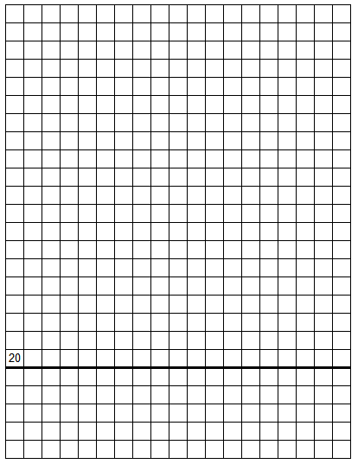
Challenge Stage 5
Regular Stage 1
PISTOL HOUUSE
30’ = 3.84” 1’ = 0.128”
PCC
Rack
CHAIR
P1
P2
TABLE
P3
P4
SP
T7
DDT
8
8
8
8
8
3
3
3
x1
x2
T1
T2
T3
T9
T1
T1
DT
6
6
6
6
x1
x2
T4
T5
T6
T3
T4
4
4
4
4
T6
T4
Out & Back
Out & Back
T7
T8
T9
T1
T1

Slide 11
Tri-County Sportsmen’s League – IDPA
THUGS INVADE YOUR SPORTING GOODS STORE
Stage #5
2024 Challenge
Challenge Stage 5
Regular Stage 1
PISTOL HOUUSE
Concealment: | Yes | Pistol & PCC: | Pistol and PCC loaded to division capacity and placed flat on table, trigger guard over X, muzzle pointed down range. | Scoring: Start / Stop | Unlimited Audible / Last Shot
Style: | Freestyle | Reload: | IDPA Approved | Min. Rounds: | 18
Start: | Seated in chair (X) outside your sporting goods shop.
Procedure: | Retrieve firearm and engage threats with 2 rounds each in tactical priority as they become visible, from cover and in the open.
**Notes: | T1 is a surprise target and engaged in the open. 180-degree muzzle rule in effect.
See you Next Year at the 2025 Tri-County Sportsmen Challenge
CoF designed by: Steve Nesmith

Slide 12
Challenge Stage 6
100 Yard Rifle Range
30’ = 4.30” 1’ = 0.143”
T7
DDT
PCC
Rack
T1
T2
T3
T9
T1
T1
DT
T4
T5
T6
T3
T4
CHAIR
T6
T4
Out & Back
Out & Back
P1
P2
T7
T8
T9
T1
T1
SP
P3
P4
TABLE
8
8
8
8
8
3
3
3
6
6
6
6
4
4
4
4
x1
x2
x1
x2

Slide 13
Tri-County Sportsmen’s League – IDPA
Mine Cart
Stage #6
Challenge 2024
Challenge Stage 6
100 Yard
Rifle Range
Concealment: | Yes | Pistol and PCC: | Pistol and PCC loaded to division capacity and held at low ready. | Scoring: Start / Stop | Unlimited Audible / Last Shot
Style: | Freestyle | Reload: | IDPA Approved | Min. Rounds: | 18
Start: | Behind cart, between tracks (X). One foot touching the end board of the track. Pistol and PCC loaded and at low ready.
Procedure: | Engage targets with 2 rounds each as they become visible when pushing the cart along the track. The targets are engaged from within the shooting box fault lines which are attached to the cart.
**Notes: | 180-degree muzzle rule in effect.
See you in OCTOBER at the TCSL IDPA monthly match!!!
CoF designed by: ERA3

Slide 14
Non-Shaded area (15’)
is relatively flat. Should
be ok for walls.
Area shaded YELLOW
Is a bit of an incline to
the sides. Not good for walls. Can be used for target placement.
Challenge Stage 7
185-yard rifle range
15 feet = 2.03 inches
1 foot = 0.135 inches
T7
PCC
Rack
T1
T2
T3
T9
T1
T4
T5
T6
T3
T4
CHAIR
T7
T8
T9
T6
T4
T1
TABLE
DT
DDT
Out & Back
Out & Back
P1
P2
T1
T1
SP
P3
P4
8
8
8
8
8
3
3
3
6
6
6
6
4
4
4
4
x1
x2
x1
x2

Slide 15
Tri-County Sportsmen’s League – IDPA
Standards Stage
Stage #7
Challenge 2024
Challenge Stage 7
185 Yard
Rifle Range
Concealment: | Yes | Pistol: PCC: | Pistol loaded with 6 rounds only and holstered. PCC loaded with 6 rounds only, held at low ready. | Scoring: Start / Stop | Limited Audible / Last Shot
Style: | SH., WH. | Reload: | IDPA Approved | Min. Rounds: | 18
Start: | Facing DOWN range. Pistol: Surrender position (wrists above shoulders). Downloaded to 6 at (X). PCC: Low ready. Downloaded to 6 at (X).
Procedure: | From within fault lines engage all targets with 1 round each, THEN engage all targets with 1 round each, THEN engage all targets with 1 round each. Each target will score the best 3 hits. One pass must be shot WHO. Two passes must be shot SHO.
**Notes: | 180 degree muzzle rule in effect.
Don’t forget to sign up for the October TCSL monthly match!
CoF designed by: ERA3

Slide 16
8
8
8
8
8
Challenge Stage 8
North Turkey Bay
30 feet = 3.51 inches
1 foot = 0.117 inches
6
6
6
6
x1
x2
4
4
4
4
3
3
3
x1
x2
T7
DDT
PCC
Rack
T1
T2
T3
T9
T1
T1
DT
T4
T5
T6
T3
T4
CHAIR
T6
T4
Out & Back
Out & Back
P1
P2
T7
T8
T9
T1
T1
SP
P3
P4
TABLE

Slide 17
Tri-County Sportsmen’s League – IDPA
“Who let the dogs out”
You’re at the dog park, when a dog fight causes a hostile incursion.
Stage #8
Challenge 2024
Challenge Stage 8
North Turkey Bay
Concealment: | Yes | Pistol and PCC: | All firearms unloaded, in rack. First mag / loading device in hand. | Scoring: Start / Stop | Unlimited Audible / Last Shot
Style: | Freestyle | Reload: | IDPA Approved | Min. Rounds: | 17
Start: | At (X), facing down range. Both palms flat on mark on wall.
Procedure: | Draw / Retrieve firearm, engage all threats with 2 rounds each as they become visible using available cover.
**Notes: | T2 is shot through the open port. Steel leg at T4 activates drop out target. S2 at P2 activates drop turner T7. 180 degree muzzle rule in effect. Steel must fall to be scored.
See you next year at the 2025 Tri-County Sportsmen Challenge
CoF designed by: Pam Hasselbach

Slide 18
Challenge Stage 9
North Turkey Bay
30 feet = 4.26 inches
1 foot = 0.142 inches
8
8
8
8
8
x1
x2
6
6
6
6
x1
x2
3
3
3
4
4
4
4
T7
DDT
PCC
Rack
T1
T2
T3
T9
T1
T1
DT
T4
T5
T6
T3
T4
Out & Back
Out & Back
P1
P2
CHAIR
T7
T8
T9
T6
T4
T1
T1
SP
P3
P4
TABLE

Slide 19
Tri-County Sportsmen’s League – IDPA
Nautical Museum Mayhem
You’re touring the WWII Submarine Display at the Nautical Museum
when mayhem breaks out – Save the Sub.
Stage #9
Challenge 2024
Challenge Stage 9
South Turkey Bay
Concealment: | Yes | Pistol: PCC: | Pistol loaded to division capacity and holstered. PCC loaded to division capacity and held low ready in strong hand. | Scoring: Start / Stop | Unlimited Audible / Last Shot
Style: | S.H., F.S. | Reload: | IDPA Approved | Min. Rounds: | 18
Start: | Standing at P1 (X). Weak hand on periscope. PISTOL: Strong hand relaxed at side. PCC: Strong hand holding PCC.
Procedure: | From behind forward fault line, engage T1 with 4 rounds, THEN engage T2 and T3 with 1 round each. All remaining targets are engaged from cover positions with 1 round each. Pull down periscope to expose T2 and T3. Turning wheels will open doors
**Notes: | 180-degree muzzle rule in effect. You must turn the wheel at the side of each door to open the door.
Don’t forget to sign up for the October TCSL monthly match!
CoF designed by:ERA3

Slide 20
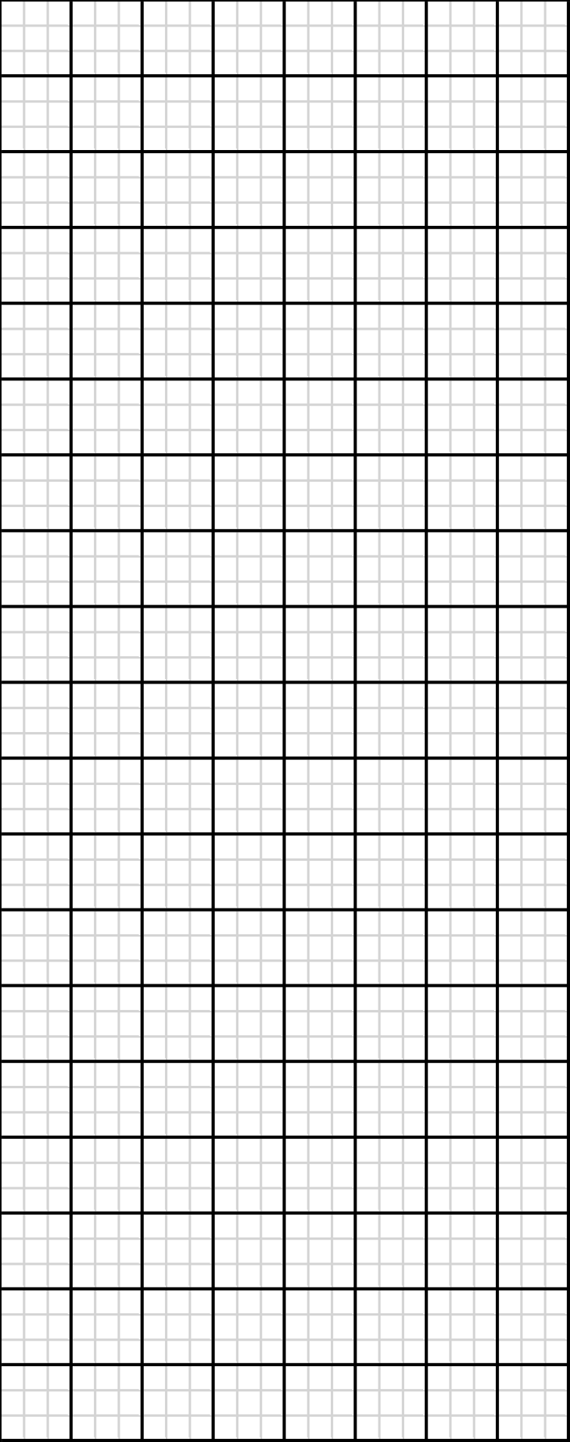
Warm-Up Stage
All Bays
8
8
6
6
4
4
3
3
T1
T2
T3
T4
T5
T6
T7
T8
P1
P2
x2
P3
P4
T9
T6
T7
T4
T9
T9
x1
x2
x1
T1
T1

Slide 21
Tri-County Sportsmen's League IDPA
Standard Stage - Warm up Stage
Stage #10
Challenge2024
Warn-Up
Concealment: | Yes | Pistol: PCC: | Pistol loaded with 6 rounds only and holstered. PCC loaded with 6 rounds only and held low ready. | Scoring: Start / Stop | LIMITED Audible / Last Shot
Style: | FREESTYLE | Reload: | IDPA Approved | Min. Rounds: | 12
Start: | Standing behind fault line.
Procedure: | Form behind forward fault line engage T1 – T3 with 2 rounds each, THEN engage targets T1 – T3 with 2 rounds.
**Notes: | Both Pistol and PCC will start with SIX ROUNDS ONLY. For scoring, there must be 2 hits to each head and 2 hits to each body. Best 2 hits to the body and the head will be scored. 180-degree muzzle rule in effect.
See you next year at the 2025 Tri-County Sportsmen Challenge
CoF designed by: ERA3

