Slide 1
T1
T1
T2
T4
T1
T1
T9
T9
T6
T6
T 6
T6
T6
T1
T1
T1
Swinger
Swinger
DT
Swinger
T1
P1
P2
P3
P4
The Car
TABLE
CHAIR
x1
Toilet
x2
Bush
Barricade
Plate Rack
PROPS

Slide 2
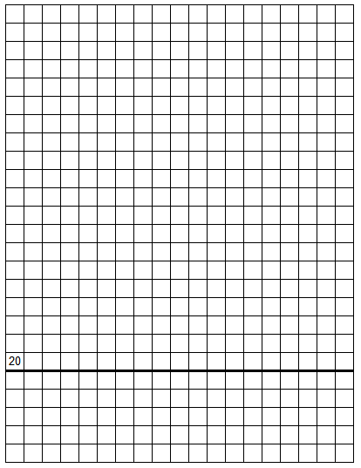
Tri-County Sportsmen’s League
Stage #1
Pistol House
x2
Concealment: | Yes | Pistol: | Loaded and Holstered | Scoring: | Unlimited
Style: | Freestyle | Reload: | IDPA Approved | Min. Rounds: | 18
Start: | Facing down range , centered on wall (X) both hands touching the wall. asss
At Signal: | Draw, move to P1 thru P5 and engage target as you see them.
**Notes: | 180 degree muzzle rule in effect. 2 hits on carboard. Steel must fall to be scored.
See you in September 2022 at the Tri-County Sportsmen Challenge IDPA Match?
CoF designed by: ERA3

Slide 3
STAGE #1 – Pistol House

Slide 4
Tri-County Sportsmen’s League - IDPA
Stage #2
Plate Rack Bay
x2
Concealment: | Yes | Pistol: | Loaded and Holstered | Scoring: | Unlimited
Style: | Freestyle | Reload: | IDPA Approved | Min. Rounds: | 18
Start: | Facing down range , centered on wall (X) both hands touching the wall. asss
At Signal: | Draw, move to P1 thru P5 and engage target as you see them.
**Notes: | 180 degree muzzle rule in effect. 2 hits on carboard. Steel must fall to be scored.
See you in September 2022 at the Tri-County Sportsmen Challenge IDPA Match?
CoF designed by: ERA3

Slide 5
STAGE #2 – Plate Rack Bay

Slide 6
Tri-County Sportsmen’s League - IDPA
Stage #3
x2
Concealment: | Yes | Pistol: | Loaded and Holstered | Scoring: | Unlimited
Style: | Freestyle | Reload: | IDPA Approved | Min. Rounds: | 18
Start: | Facing down range , centered on wall (X) both hands touching the wall. asss
At Signal: | Draw, move to P1 thru P5 and engage target as you see them.
**Notes: | 180 degree muzzle rule in effect. 2 hits on carboard. Steel must fall to be scored.
See you in September 2022 at the Tri-County Sportsmen Challenge IDPA Match?
CoF designed by: ERA3

Slide 7
x2
T1
T1
T1
STAGE #3
Scale: each box is 1 yard.

Slide 8
Tri-County Sportsmen’s League - IDPA Scenario
Standards
Stage #4
x2
Concealment: | Yes | Pistol: | Loaded and Holstered | Scoring: | Unlimited
Style: | Freestyle | Reload: | IDPA Approved | Min. Rounds: | 18
Start: | Facing down range , centered on wall (X) both hands touching the wall. asss
At Signal: | Draw, move to P1 thru P5 and engage target as you see them.
**Notes: | 180 degree muzzle rule in effect. 2 hits on carboard. Steel must fall to be scored.
See you in September 2022 at the Tri-County Sportsmen Challenge IDPA Match?
CoF designed by: ERA3

Slide 9
Stage #4
T1
T1
T1
STAGE #4
Scale: each box is 1 yard.

Slide 10
Tri-County Sportsmen’s League
Stage #5
Pin Shoot Bay
x2
Concealment: | Yes | Pistol: | Loaded and Holstered | Scoring: | Unlimited
Style: | Freestyle | Reload: | IDPA Approved | Min. Rounds: | 18
Start: | Facing down range , centered on wall (X) both hands touching the wall. asss
At Signal: | Draw, move to P1 thru P5 and engage target as you see them.
**Notes: | 180 degree muzzle rule in effect. 2 hits on carboard. Steel must fall to be scored.
See you in September 2022 at the Tri-County Sportsmen Challenge IDPA Match?
CoF designed by: ERA3

Slide 11
T1
T1
x2
STAGE #5 – Pin Rack Bay
Scale: each box is 1 yard
RED squares at top are Pin Rack Posts.

Slide 12
Tri-County Sportsmen’s League
Stage #6
100 yd range Challenge only
Concealment: | Yes | Pistol: | Loaded and Holstered | Scoring: | Unlimited
Style: | Freestyle | Reload: | IDPA Approved | Min. Rounds: | 18
Start: | Facing down range , centered on wall (X) both hands touching the wall. asss
At Signal: | Draw, move to P1 thru P5 and engage target as you see them.
**Notes: | 180 degree muzzle rule in effect. 2 hits on carboard. Steel must fall to be scored.
See you in September 2022 at the Tri-County Sportsmen Challenge IDPA Match?
CoF designed by: ERA3

Slide 13
x2
STAGE #6 – 100-yard range
Challenge only
Scale: each box is 1 yard.
P1
P2
P3

Slide 14
Tri-County Sportsmen’s League - IDPA Scenario
Stage #8 & #9
T1
T1
T1
Concealment: | Yes | Pistol: | Loaded and Holstered | Scoring: | Unlimited
Style: | Freestyle | Reload: | IDPA Approved | Min. Rounds: | 18
Start: | Facing down range , centered on wall (X) both hands touching the wall. asss
At Signal: | Draw, move to P1 thru P5 and engage target as you see them.
**Notes: | 180 degree muzzle rule in effect. 2 hits on carboard. Steel must fall to be scored.
See you in September 2022 at the Tri-County Sportsmen Challenge IDPA Match?
CoF designed by: ERA3

Slide 15
STAGE #8 & #9
Scale: each box is 1 yard.
T1
T1
T1

Slide 16
STAGE #8 & #9
Scale: each box is 1 yard.
T1
T1
T1

